Slide 1
Business Access Ability Program
Paul.tingley@novascotia.ca
902-233-8379
sbaccess@novascotia.ca
-----------------------------
Investing in Our Future –
Community Funding and Awards
With CCTH

Slide 2
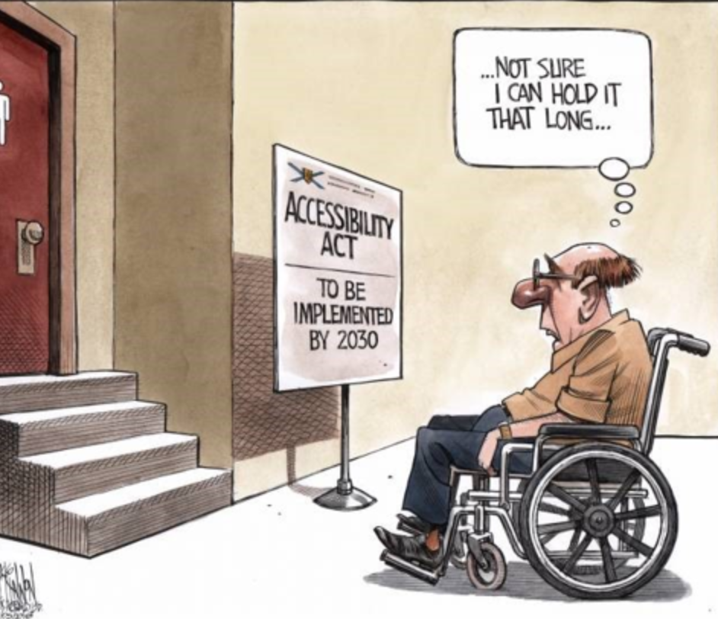

Slide 3
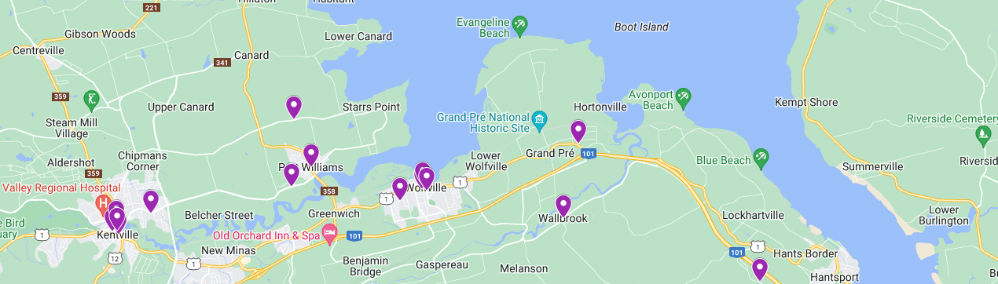
Under the Accessibility Act, Nova Scotia is committed to an accessible Nova Scotia by 2030. Meeting this goal means preventing and removing barriers to accessibility, for persons with disabilities. Businesses can apply for a cost-shared grant to make accessibility-related improvements. Improvements can be for clients and customers, for employees, or both.

Slide 4
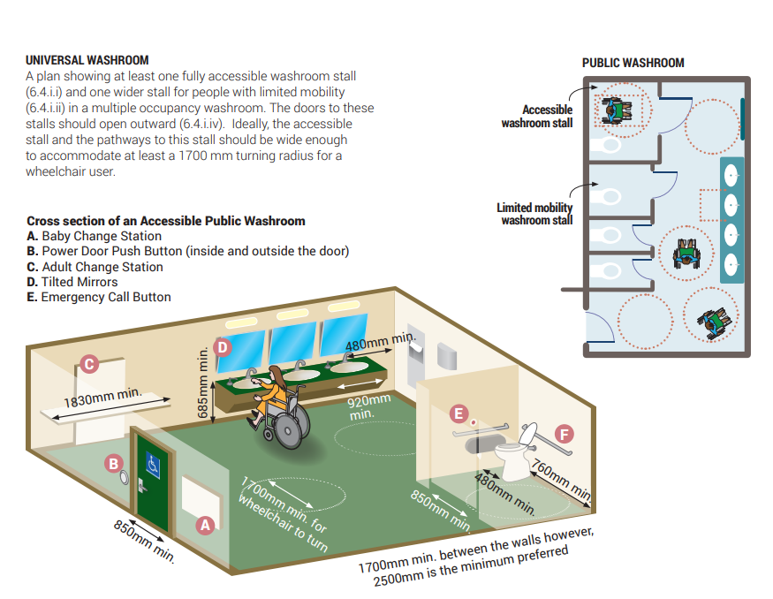
Access by Design 2030 – novascotia.ca/accessibility

Slide 5
Reasons
Greater opportunity for more customers = more profit
The right thing to do – Access for all
Legislation
2/3rds of expense covered by Province (up to $50k)

Slide 6
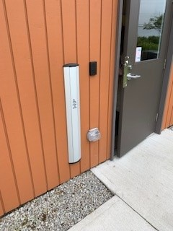
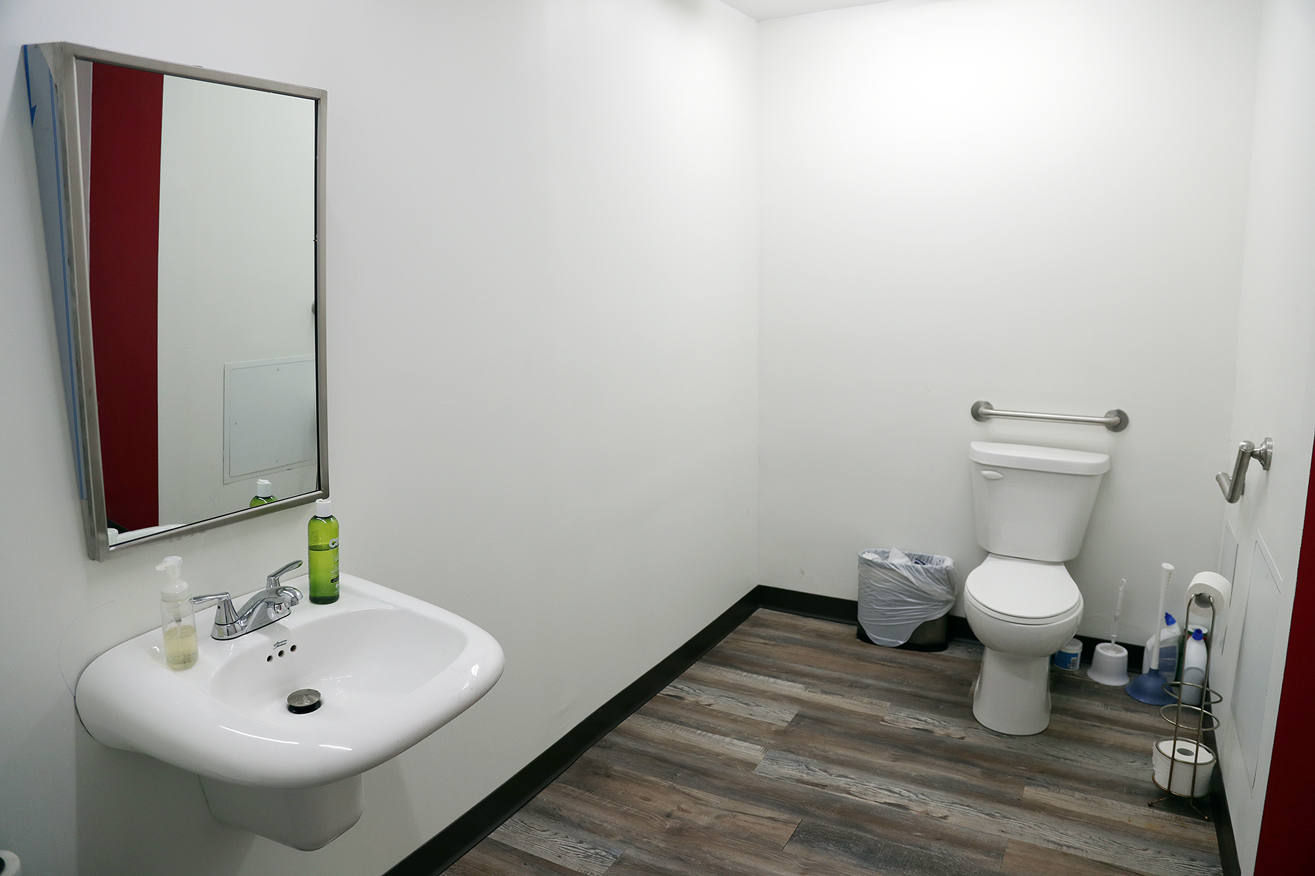
Projects by categories – Built Environment prevent and remove barriers within the built environment for persons with disabilities.
85% projects are entrances, pathways & bathrooms

Slide 7
Accessible Communications Services - Ensure that all customers, clients, and employees can access information related to a business.

Slide 8
Assistive Devices: employees and consumers who are person with disabilities have the devices they need to effectively do their jobs and access places of business.

Slide 9
Accessible Transportation Improve options for persons with disabilities via access to shuttle services, fleet vehicles, and taxis

Slide 10
Universal Design Capacity Building – education and stakeholder engagement

Slide 11
The Kentville Accessibility Advisory Committee

Slide 12
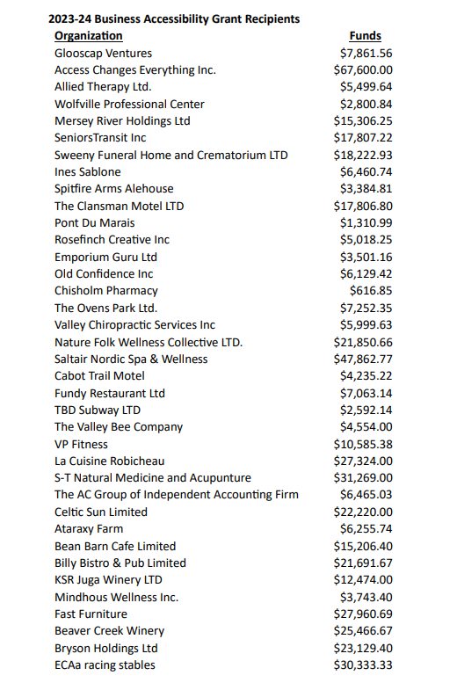
Thank you!

